Slide 1


PREDICTION OF DIABETES
PIMA INDIAN
DATASET

Slide 2
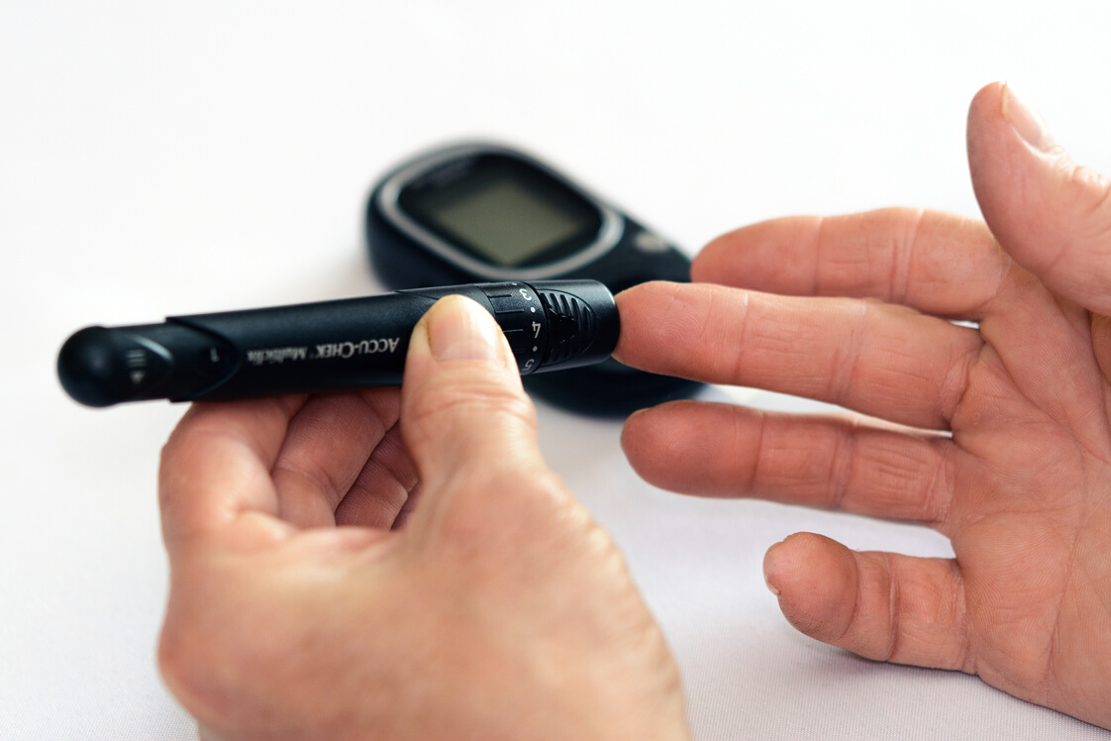

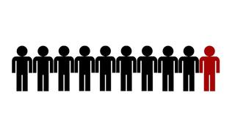
WHAT IS
DIABETES ?
Diabetes is a chronic condition that occurs when the body loses its ability to produce or properly use insulin.
By 2025
5 Million Canadians
( 12% of the population)
Over 3 Million Canadians
( 9% of the population)
1 in 10 adults

Slide 3
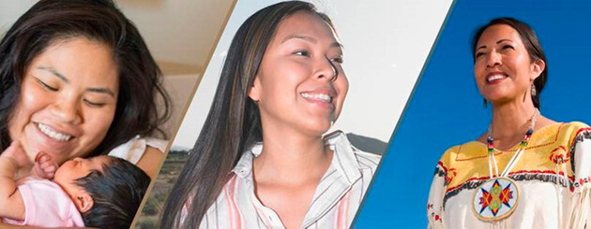
Pima Indian
The Pima Indian Diabetes (PID) dataset:
768 records
Females patients of Pima Indian Heritage which are at least 21 years old.
Living near Phoenix, Arizona, USA

Slide 4
PID - Attributes
1. Number of times pregnant
2. Plasma glucose concentration a 2 hours in an oral glucose tolerance test
3. Diastolic blood pressure (mm Hg)
4. Triceps skinfold thickness (mm)
5. 2-Hour serum insulin (mu U/ml)
6. Body mass index (weight in kg/(height in m)^2)
7. Diabetes pedigree function
8. Age (years)
9. Outcome - Class variable (0 or 1)
Independents
Risk factors
Dependent
Diabetes/
No Diabetes

Slide 5


PROJECT OBJECTIVE
To predict diabetes based on diagnostic measurements available in the PID dataset.
Identifying which type of algorithm model works best for this prediction.

Slide 6
1.DATA PREPARATION
Summary
Outliers
Predictor Attributes
Data Analysis
Correlation
Data Cleaning
Feature Selection

Slide 7
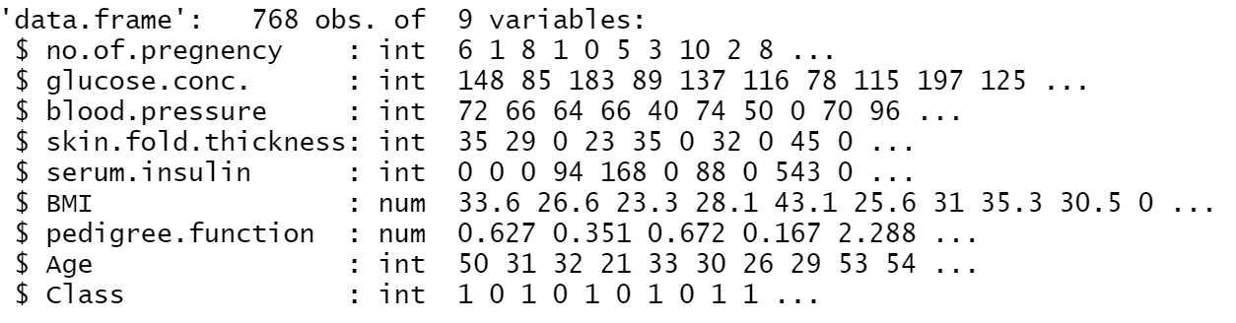
Summary of Attributes
All the attributes in this dataset are quantitative type, both numeric and integer.

Slide 8
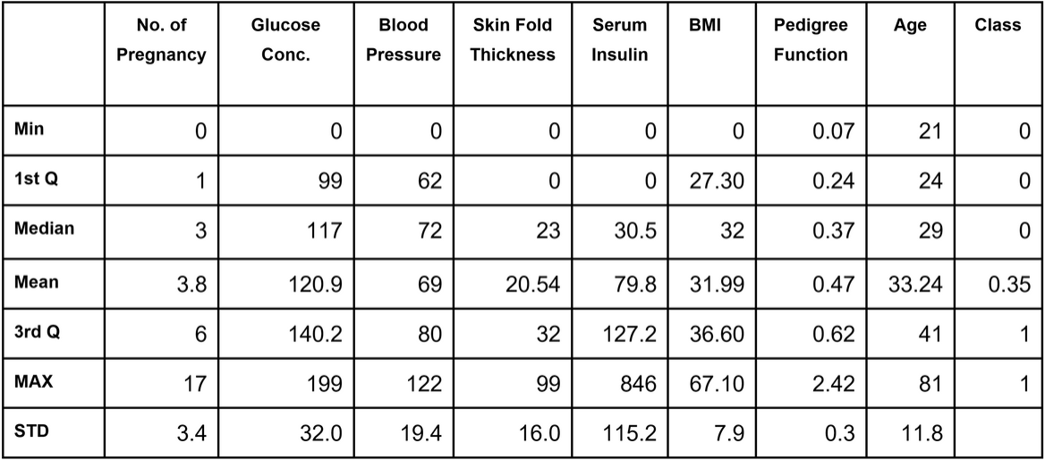
Summary of Attributes, Cont’s

Slide 9
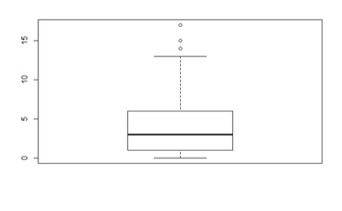
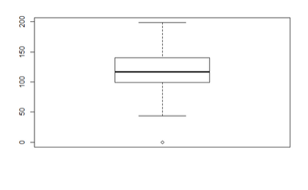
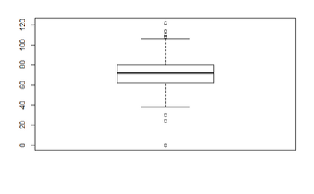
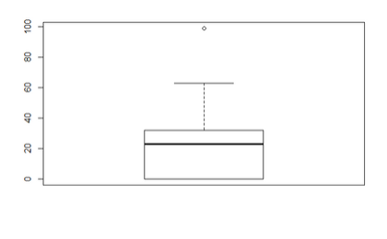
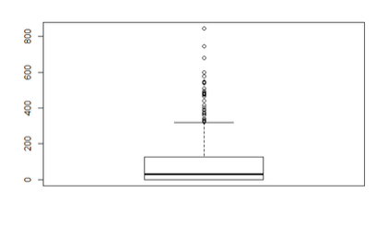
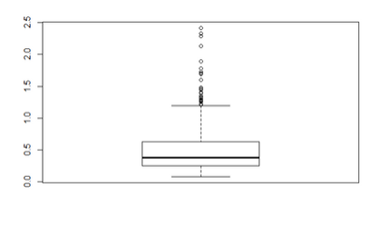
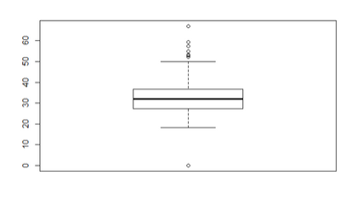
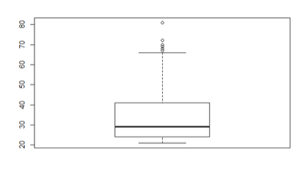
Outlier Values
Pregnancy
Glucose
Blood Pressure
Skin Fold Thickness
Serum Insulin
pedigree.function
BMI
Age

Slide 10
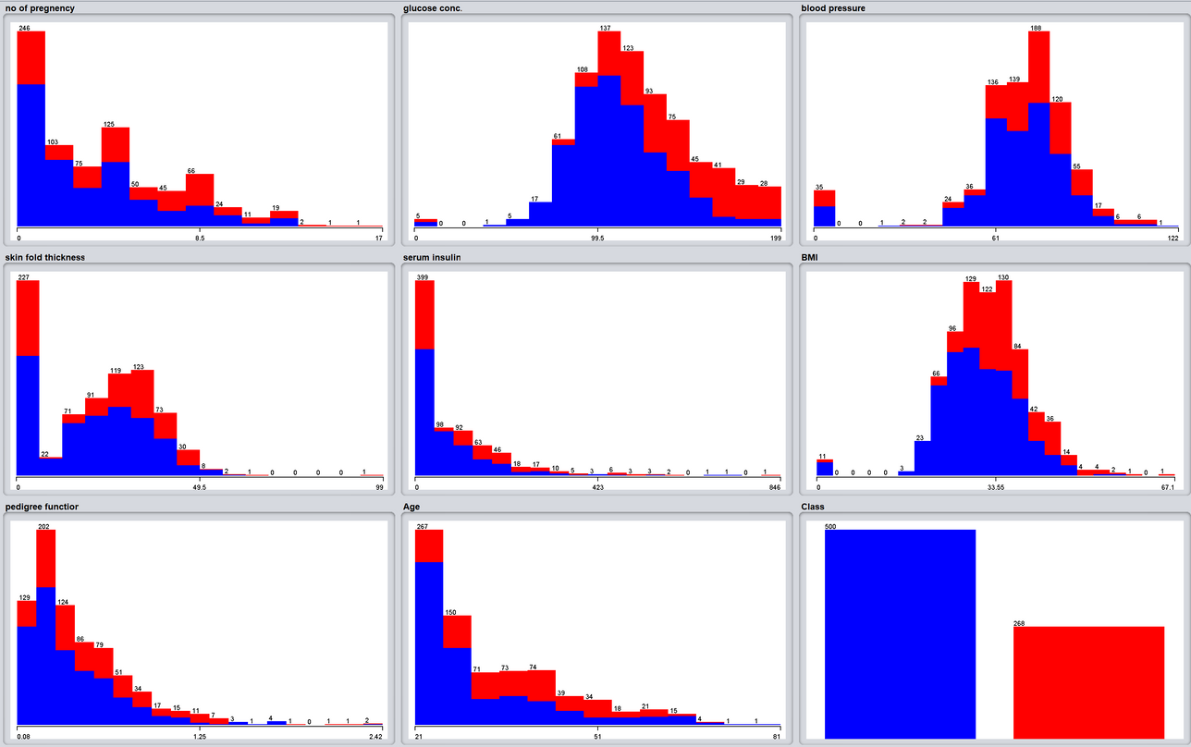
Predictor Attributes
500 Non
Diabetes
268
Diabetes
Glucose, Blood Pressure, Skin Thickness, BIM attributes look normally distributes

Slide 11
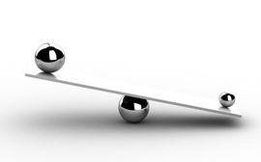
Data Analysis
The dataset reflects an imbalanced class distribution
Value 0 (Non-Diabetes): 500
Value 1 (Diabetes): 268
500 Non
Diabetes

Slide 12
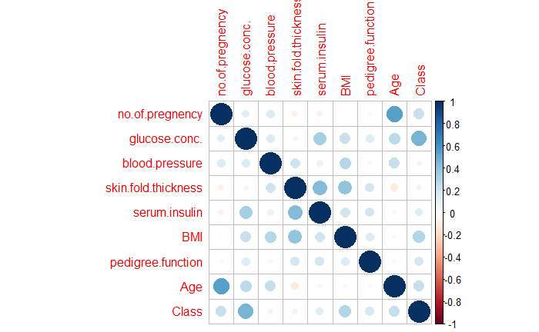
Correlation
Attributes that seems to be more correlated
Age
No.of pregnancy
Serum insulin
Skinfold thickness
Glucose
Serum insulin
The attributes correlated to the class
Glucose
Class
BMI
Class

Slide 13
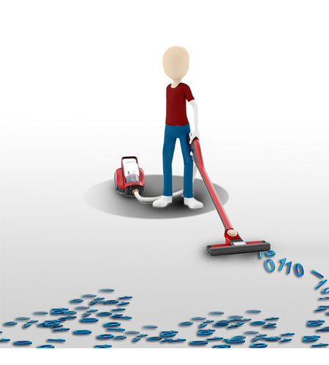
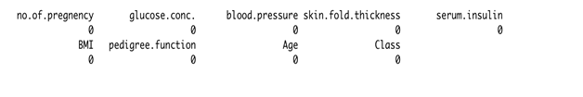

Data Cleaning and
Transformation
Dataset does not have N/A Values
Identify zero values of the attributes which could not be zero such
Zero values were substituted with the median value of the attributes
Class attribute was transformed from numeric to nominal
BMI
Glucose
Blood Pressure
Serum Insulin
Skinfold Thickness

Slide 14
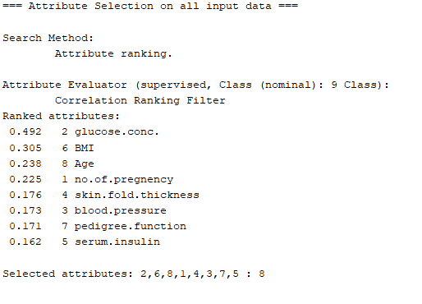
Feature selection
HIGH
MODERATE
LOW

Slide 15
2.DATA MODELING
Decision Tree
Naïve Bayes
Logical Regression

Slide 16
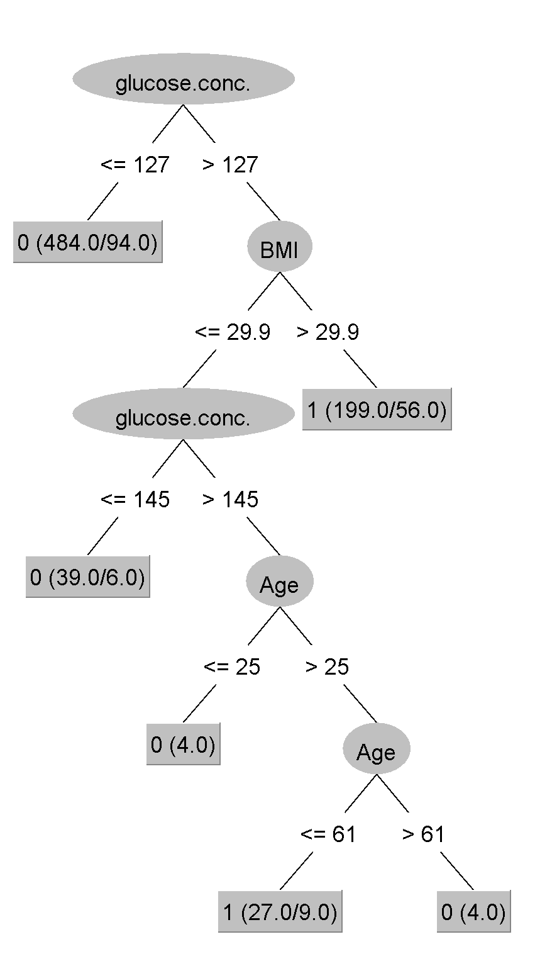
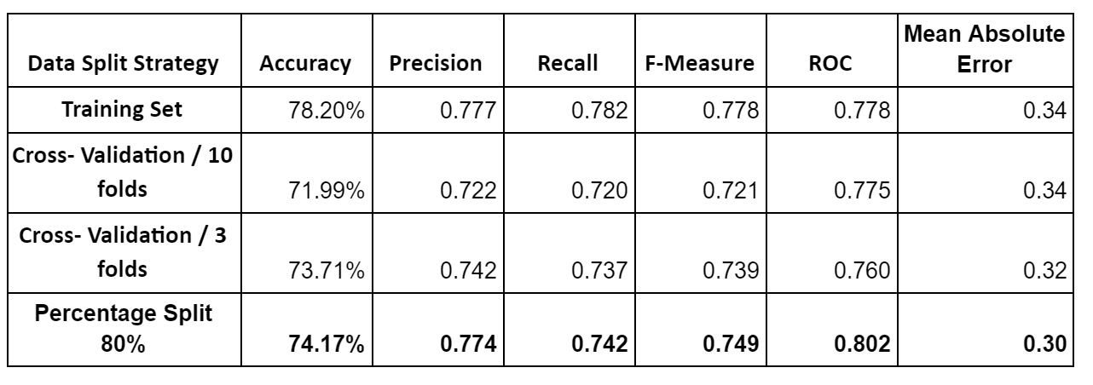
Decision Tree
Dataset Split Experiment
Default (pruned): 74.17% accuracy, tree has 6 leaves, 11 nodes
Unpruned: 74.16% accuracy 10 leaves, 19 nodes

Slide 17
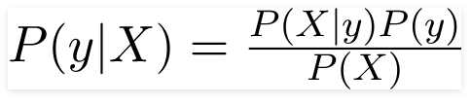
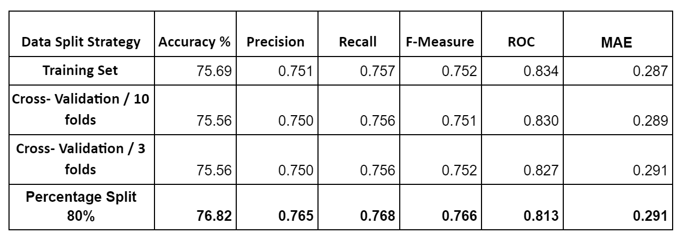
Naive Bayes

Slide 18
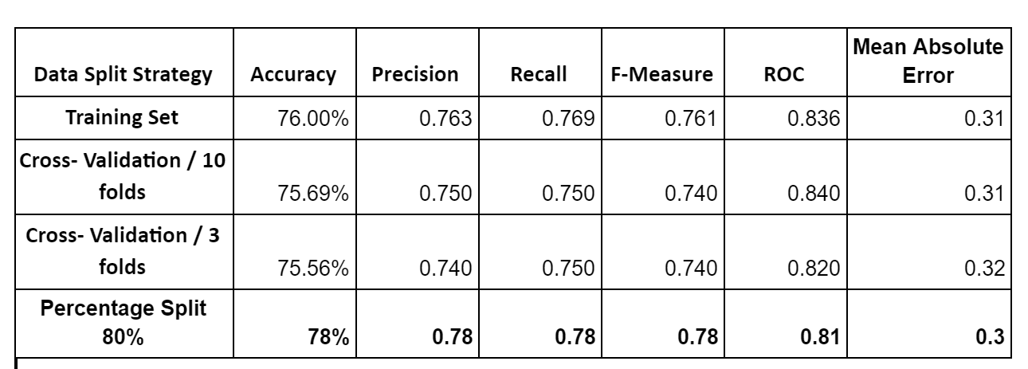
Logical Regression
Logistic regression is a supervised classification algorithm that can predict the probability of a dependent variable.

Slide 19
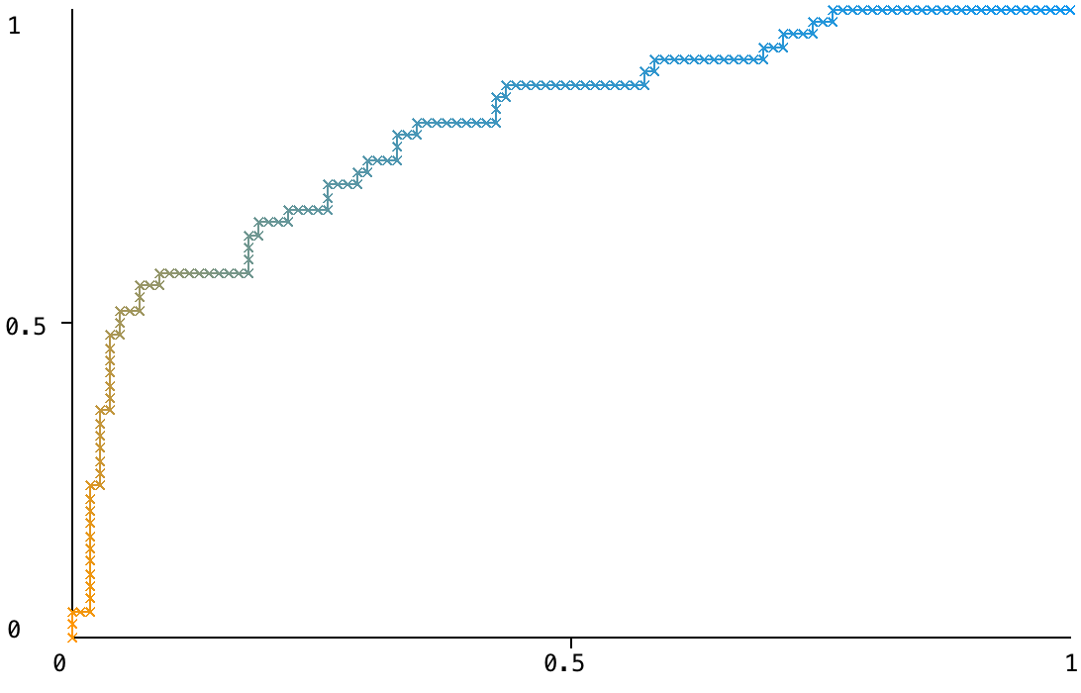
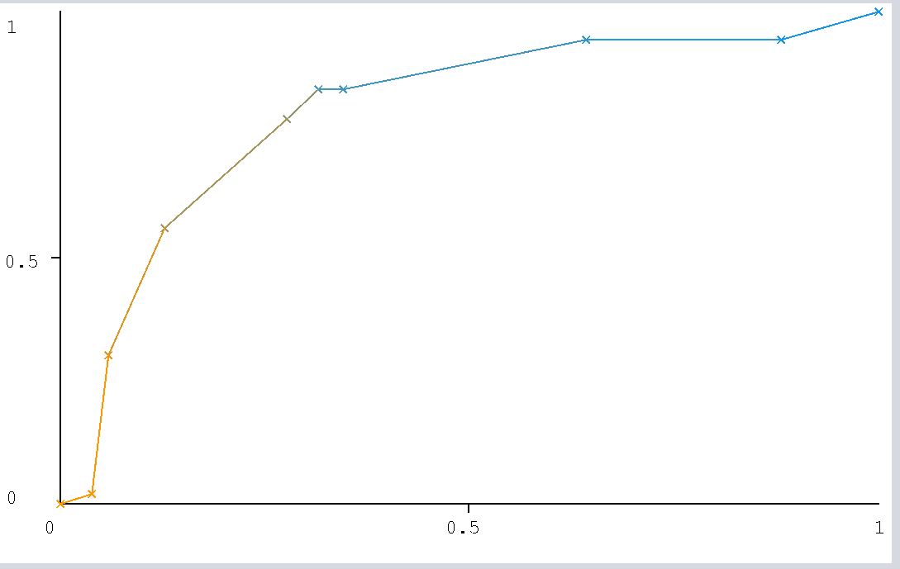
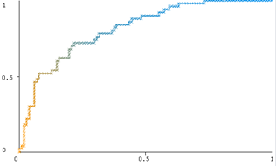
ROC Curves
Logic Regression
Y= True Positive Rate
X= False Positive Rate
Decision Tree
Naïve Bayes
Y= True Positive Rate
Y= True Positive Rate
X= False Positive Rate
X= False Positive Rate

Slide 20
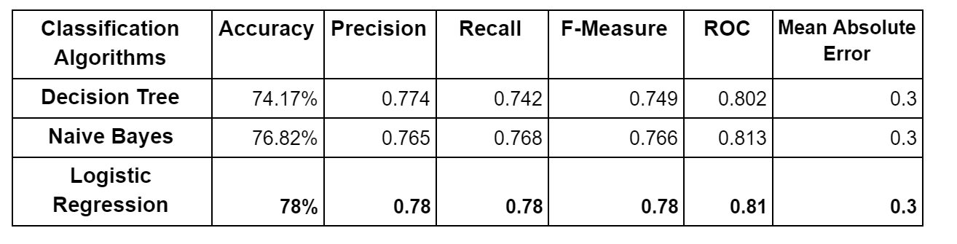
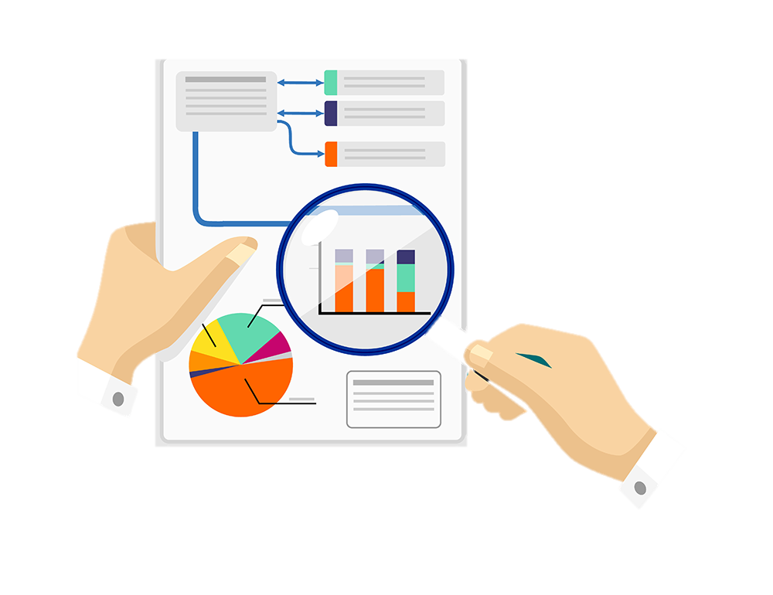
COMPARISON
Comparative Performance of Classification Algorithms on Various Measures
Logistic Regression is the better model to predict diabetes

Slide 21
3.POST-PREDICTION
ANALYSIS
Clustering
Association Rule

Slide 22
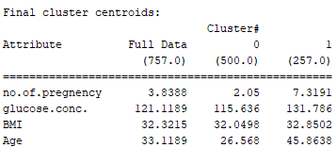
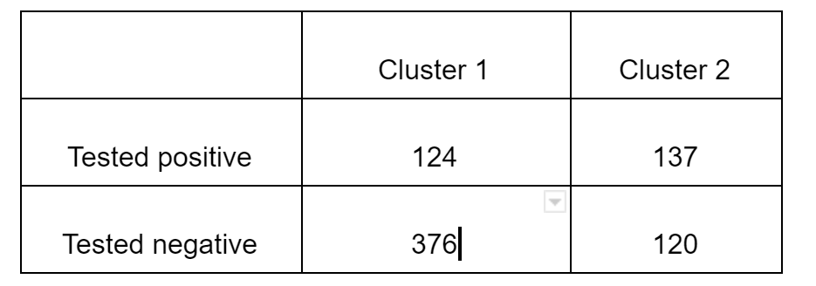
Clustering
Clustering was applied by initially setting the value of K = 2
Clustering was applied by initially setting the value of K = 2
Incorrectly classified instances were 32.23% which show that the accuracy of K-means clustering method was 67.77%.

Slide 23
Association Rule
Apriori Algorithm
268 patients with diabetes in the dataset
1. Determines the frequent item set
2. Generate rules
Best rules are shown:
Rule1: If (BMI= high ∩ glucose.conc.= high) → Class = Yes
Rule2: If (Age = high ∩ glucose.conc.= high) → Class = Yes
Rule3: If (no.of.pregnancy = high ∩ age= high) → Class = Yes
Rule4:If (BMI = high ∩ glucose.conc.= high) → Class = Yes

Slide 24

CONCLUSIONS
The Logic Regression model shows the best performance with the highest accuracy of 78% with a ROC of 81% when compared to Decision Tree and Naive Bayes models.
According to the Pima Indian dataset study Glucose is the stronger contributor for predicting diabetes.
The methods utilized in this study could be used to train a model to predict a person's diabetes by taking inputs features like Glucose, BMI, Age and No. of Pregnancy.
The study for this dataset has some limitations such as: the target is defined as females older than 21 years which could be extended to male patients as well. By including both genders in the dataset, the prediction of diabetes would work in general and not for a specific community.

Slide 25
Thank You

